Slide 1


CS-446: Information Systems Security
Lecture # 4: Block Ciphers
Prof. Dr. Sufian Hameed
Department of Computer Science
FAST-NUCES

Slide 2
Modes of Encryption

Slide 3
Chapter 04
Objectives
❏ To show how modern standard ciphers, such as DES or AES, can be used to encipher long messages.
❏ To discuss five modes of operation designed to be used with modern block ciphers.
❏ To define which mode of operation creates stream ciphers out of the underlying block ciphers.

Slide 4
Block Ciphers Modes of Operation
The modes of operation of block ciphers are configuration methods that allow those ciphers to work with large data streams, without the risk of compromising the provided security.
It is not recommended, however it is possible while working with block ciphers, to use the same secret key bits for encrypting the same plaintext parts. Using one deterministic algorithm for a number of identical input data, results in some number of identical ciphertext blocks.
This is a very dangerous situation for the cipher's users. An intruder would be able to get much information by knowing the distribution of identical message parts, even if he would not be able to break the cipher and discover the original messages.
Luckily, there exist ways to blur the cipher output.
The idea is to mix the plaintext blocks (which are known) with the ciphertext blocks (which have been just created), and to use the result as the cipher input for the next blocks. As a result, the user avoids creating identical output ciphertext blocks from identical plaintext data.
These modifications are called the block cipher modes of operations.

Slide 5
USE OF MODERN BLOCK CIPHERS
Symmetric-key encipherment can be done using modern block ciphers. Modes of operation have been devised to encipher text of any size employing either DES or AES.
Topics discussed in this section:
8.1.1 Electronic Codebook (ECB) Mode 8.1.2 Cipher Block Chaining (CBC) Mode
8.1.3 Cipher Feedback (CFB) Mode
8.1.4 Output Feedback (OFB) Mode
8.1.5 Counter (CTR) Mode

Slide 6
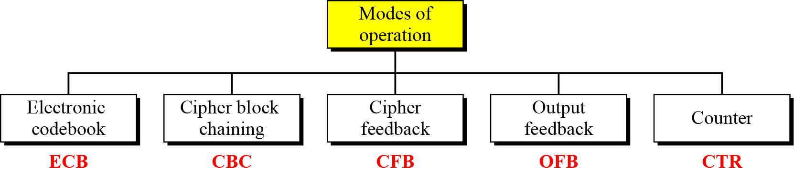
Continued
Figure Modes of operation

Slide 7
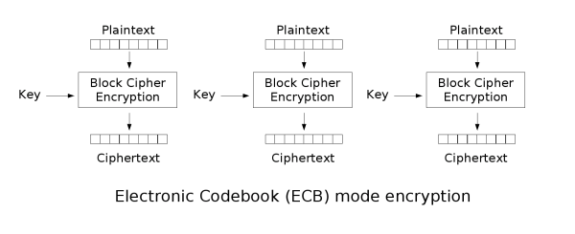
Electronic Codebook (ECB) mode
Simplest method: divide a message into blocks and encrypt each one
Advantage: fast access to single blocks
*image source = wiki (also for several following images)

Slide 8
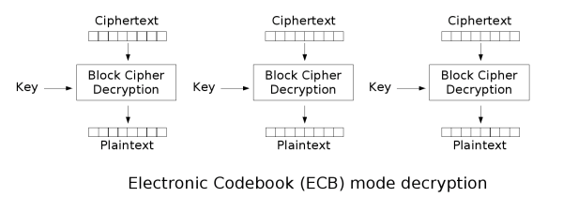
Electronic Codebook (ECB) mode
Does not hide data patterns well and doesn't provide serious message confidentiality
Not recommended for use in cryptographic protocols at all.
Make protocols without integrity protection more susceptible to replay attacks
Each block gets decrypted in exactly the same way.
*image source = wiki (also for several following images)
Notes:
Larger the key, more secure, but more slow

Slide 9
Electronic Codebook (ECB) mode
Disadvantage: Too simple, too dangerous; does not satisfy the requirements
Identical blocks are encrypted to the same cipher block and can be identified by an attacker i.e. if m₁=m₂ then c₁=c₂
The message structure can be identified
If the attacker knows, what context the plaintext has, parts of message can be manipulated
ECB is not semantically secure for messages that contain more than one block.
Notes:
Larger the key, more secure, but more slow

Slide 10
Replay Attack
During replay attacks the intruder sends to the victim the same message as was already used in the victim's communication. The message is correctly encrypted, so its receiver may treat is as a correct request and take actions desired by the intruder.
The attacker might either have eavesdropped a message between two sides before or he may know the message format from his previous communication with one of the sides. This message may contain some kind of the secret key and be used for authentication.
For example, when one makes an order to the bank to transfer money to some specified account, the attacker may eavesdrop the frames. If that happens, the attacker can send the same (correct) messages to the bank one more time, hoping that the bank will transfer money again to the same account (probably connected with the intruder).
There are some methods to avoid replay attacks. First of all, before starting the communication both sides may negotiate and create a random session key, valid only for a specified time and during a specified process. Instead of session keys, it is also reasonable to use timestamps in all messages and accept messages that have not been sent too long ago. The other popular technique is to use one-time passwords for each request. This method of prevention is very often used for banking operations.

Slide 11


Electronic Codebook (ECB) mode
A typical example of weakness of encryption using ECB mode is encoding a bitmap image (for example a .bmp file). Even a strong encryption algorithm used in ECB mode cannot blur efficiently the plaintext.
Original Image
Encrypted using ECB mode
Notes:
Larger the key, more secure, but more slow

Slide 12
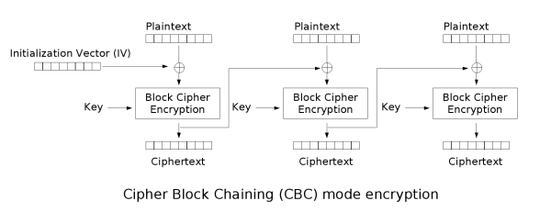
Cipher Block Chaining (CBC) mode
Invented by IBM in 1976
Each block of plaintext is XORed with the previous ciphertext block before being encrypted
Each ciphertext block depends on all plaintext blocks processed up to that point
For Uniqueness, an initialization vector (IV) must be used in the first block.
Mathematical Formula
Notes:
Larger the key, more secure, but more slow

Slide 13
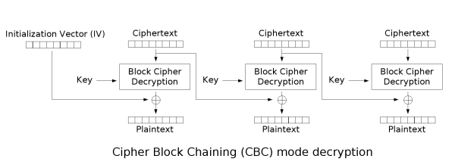
Cipher Block Chaining (CBC) mode
For each message to be encoded, a new IV should be used
Usage of the same IV for all messages would cause some problems:
Differences in similar messages can be found by an attacker
Old messages can be sent by an attacker at a later time
Chosen plaintext can be applied as an attack
Mathematical Formula
Notes:
Larger the key, more secure, but more slow

Slide 14

Cipher Block Chaining (CBC) mode
Drawback(s)
Encryption is sequential (cannot be parallelized).
A one-bit change in a plaintext or IV affects all following ciphertext blocks.
For Decryption Incorrect IV causes only the first block of plaintext to be corrupt
Plaintext block can be recovered from two adjacent blocks of ciphertext
Decryption cannot be parallelized
one-bit change to the ciphertext causes complete corruption of the corresponding block of plaintext
rest of the blocks remain intact.
Original Image
Encrypted using CBC mode
Notes:
Larger the key, more secure, but more slow

Slide 15
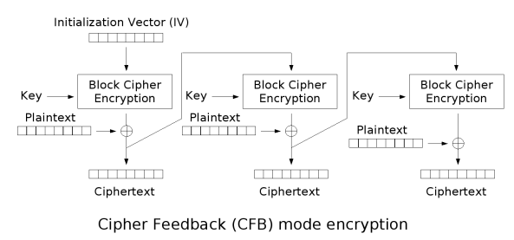

Cipher Feedback (CFB) mode
Close relative of CBC, makes a block cipher into a self-synchronizing stream cipher
Mathematical Formula
Notes:
Larger the key, more secure, but more slow

Slide 16
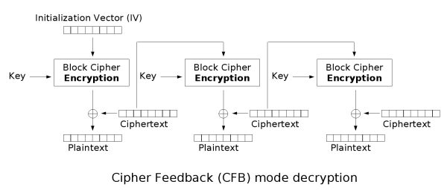
Cipher Feedback (CFB) mode
CFB decryption is almost identical to CBC encryption performed in reverse
Notes:
Larger the key, more secure, but more slow

Slide 17
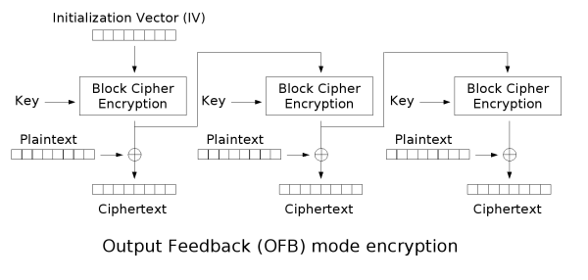
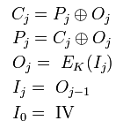
Output Feedback (OFB) mode
Makes a block cipher into a synchronous stream cipher
Just as with other stream ciphers, flipping a bit in the ciphertext produces a flipped bit in the plaintext at the same location
Mathematical Formula
Notes:
Larger the key, more secure, but more slow

Slide 18
Algorithms that work in the OFB mode create keystream bits that are used for encryption subsequent data blocks.
In this regard, the way of working of the block cipher becomes similar to the way of working of a typical stream cipher.
Because of the continuous creation of keystream bits, both encryption and decryption can be performed using only one thread at a time.
Similarly, as in the CFB mode, both data encryption and decryption uses the same cipher encryption algorithm.
If one bit of a plaintext or ciphertext message is damaged (for example because of a transmission error), only one corresponding ciphertext or respectively plaintext bit is damaged as well.
It is possible to use various correction algorithms to restore the previous value of damaged parts of the received message.

Slide 19
The biggest drawback of OFB is that the repetition of encrypting the initialization vector may produce the same state that has occurred before.
It is an unlikely situation but in such a case the plaintext will start to be encrypted by the same data as previously.

Slide 20
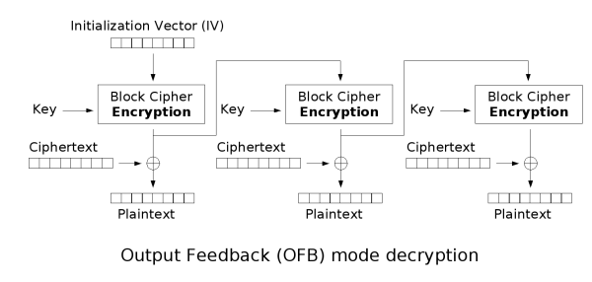
Output Feedback (OFB) mode
Because of the symmetry of the XOR operation, encryption and decryption are exactly the same:
Notes:
Larger the key, more secure, but more slow

Slide 21
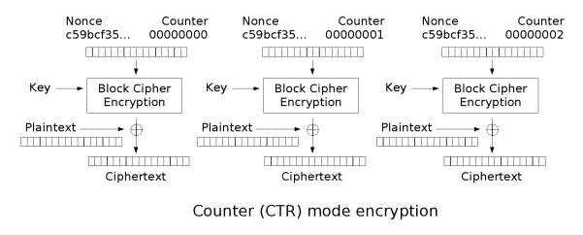
Counter Mode (CTR) mode
Like OFB, counter mode turns a block cipher into a stream cipher
The counter can be any function which produces a sequence which is guaranteed not to repeat for a long time
CTR mode is widely accepted and CBC, CTR modes are recommended by Niels Ferguson and Bruce Schneier
CTR mode is well suited to operate on a multi-processor machine where blocks can be encrypted in parallel
Notes:
Like OFB, counter mode turns a block cipher into a stream cipher. The counter can be any function which produces a sequence which is guaranteed not to repeat for a long time. CTR mode is widely accepted and CBC, CTR modes are recommended by Niels Ferguson and Bruce Schneier.
CTR mode is well suited to operation on a multi-processor machine where blocks can be encrypted in parallel.

Slide 22
CTR (Counter) Mode
Using the CTR mode makes block cipher way of working similar to a stream cipher.
As in the OFB mode, keystream bits are created regardless of content of encrypting data blocks. In this mode, subsequent values of an increasing counter are added to a nonce value (the nonce means a number that is unique: number used once) and the results are encrypted as usual.
The nonce plays the same role as initialization vectors in the previous modes.
It is one of the most popular block ciphers modes of operation.
Both encryption and decryption can be performed using many threads at the same time.

Slide 23
If one bit of a plaintext or ciphertext message is damaged, only one corresponding output bit is damaged as well.
Thus, it is possible to use various correction algorithms to restore the previous value of damaged parts of received messages.
The CTR mode is also known as the SIC mode (Segment Integer Counter).

Slide 24
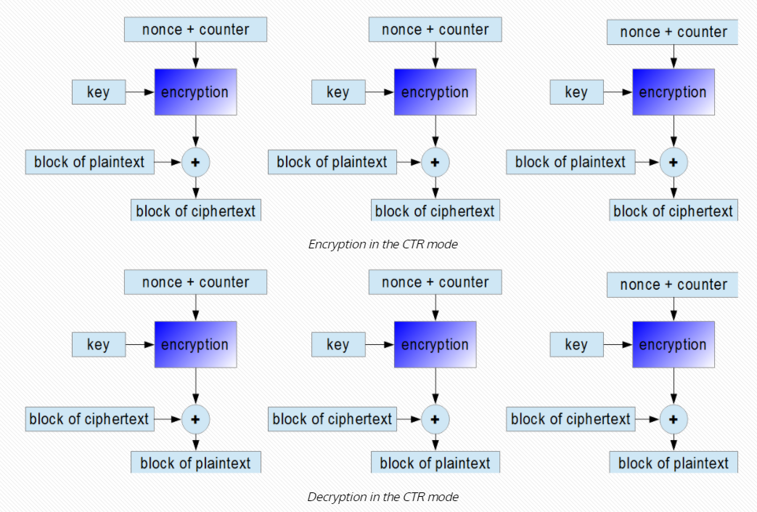

Slide 25
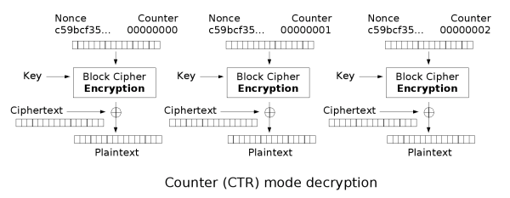
Counter Mode (CTR) mode
Notes:
Larger the key, more secure, but more slow

Slide 26
Security of the CTR mode
As in the case of the CBC mode, one should change the secret key after using it for encrypting a number of sent messages.
It can be proved that the CTR mode generally provides quite good security and that the secret key needs to be changed less often than in the CBC mode.
For example, for the AES cipher the secret key should be changed after about 2⁶⁴ plaintext blocks.

Slide 27
Acknowledgements
Material in this lecture are taken from the slides prepared by:
Prof. Dan Boneh (Stanford)
Prof. O. Spaniol (RWTH Aachen)

